Slide 1




Standalone ATM System
Course: Software Architecture and Application
Course ID: SWE30003
Lecturer: Mr.Pham Thai Ky Trung
Lecture Dat: Mondays, 13:00 - 16:00 p.m
Team Member: Lu Nhat Hoang
Duong Nguyen Dang
Truong Ngoc Gia Hieu

Slide 2




Content
System Specification and Operational Scenario
Class Identification and Responsibility Distribution
Class-Responsibility-Collaboration (CRC) Cards and Object Dependencies
Class Hierarchies and Object Modeling
Applied Design Patterns
Distributed Balance Synchronization

Slide 3

System Specification
Machine Architecture: Designed as a standalone software layout interfacing with standard physical endpoints.
Hardware Interface Components: Integrated with a display screen, bankcard reader, input keys, cash dispenser, and receipt printer.
Default System State: Displays a greeting text when idle while locking out hardware input channels.
Input Parsing & Verification: Reads inserted card metadata and validates masked user numeric credentials.
Core Business Actions: Executes dedicated financial routines for deposits, withdrawals, transfers, and balance inquiries.
System Escape Sequences: Provides an uninterrupted cancellation routine to return user cards and print logs at any active stage.

Slide 4

Operation
Scenario
Step 1: Session Initialization – Displays a default greeting message while keeping all hardware keys and slots locked until a bankcard is physically inserted.
Step 2: Security Verification – Reads card metadata, prompts for a PIN, masks numeric inputs (*), and triggers physical card retention on the third successive failure.
Step 3: Service Selection & Execution – Loads the transaction menu (Deposit, Withdrawal, Transfer, Inquiry) and runs the chosen business logic back to the main loop.
Step 4: Safe Escape Routine – Monitors the Cancel key at any active stage to terminate execution, print summary records, return the card, and reset back to idle.

Slide 5
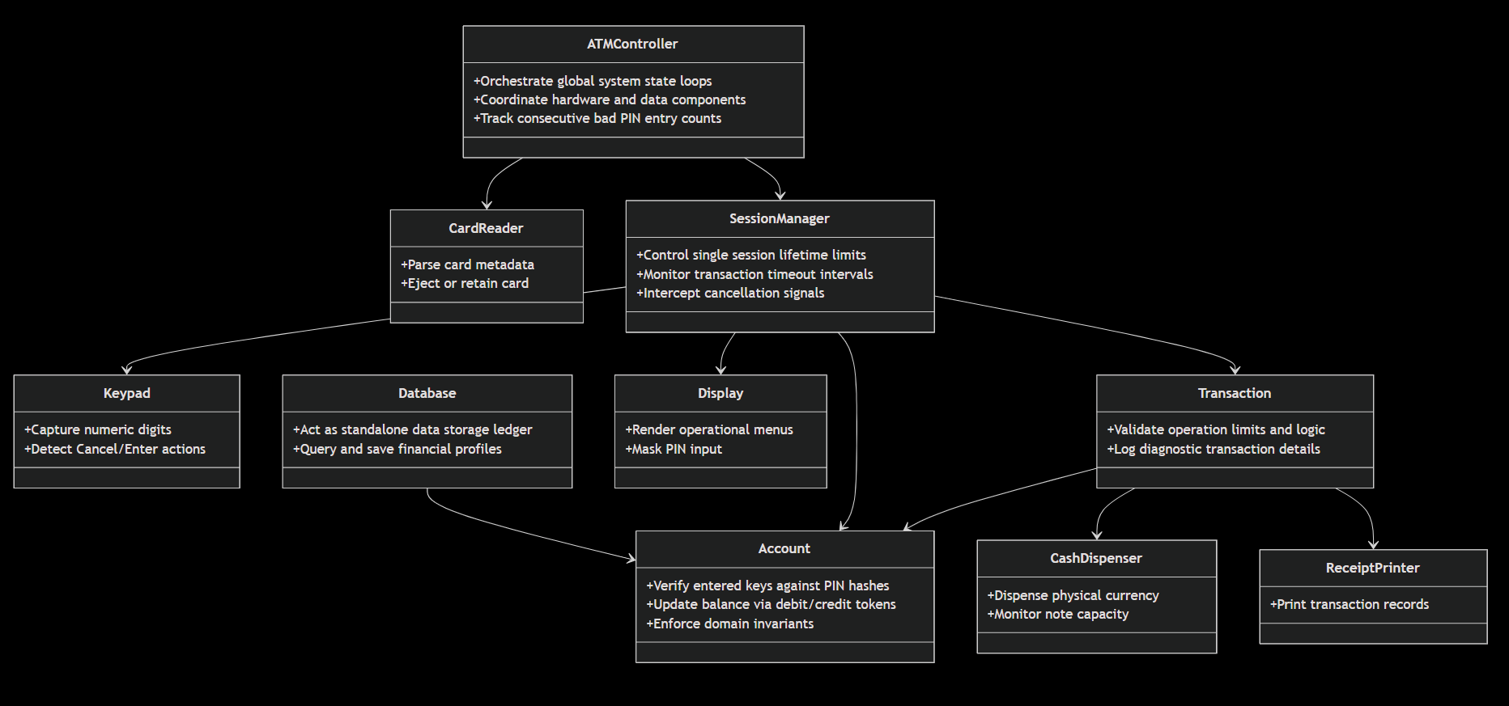
Important Classes

Slide 6
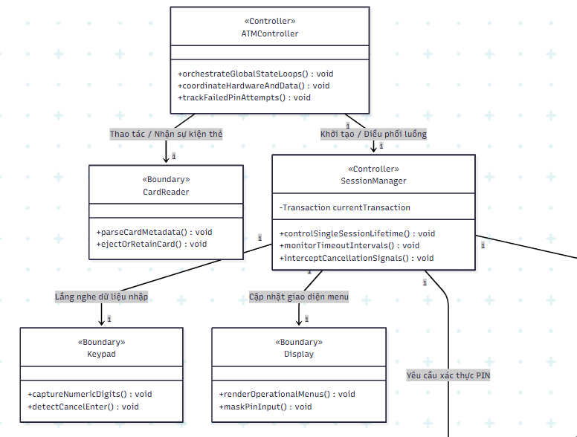
Relationship Between Classes

Slide 7
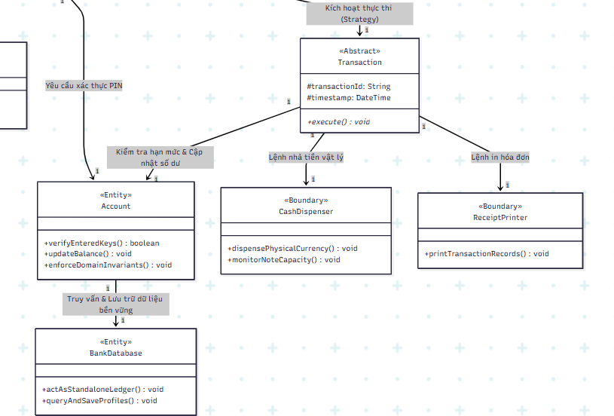
Relationship Between Classes

Slide 8



Thank you for listening

